Slide 1
PopulationSim Training 2
December 19th, 2023
Kaelem Mohabir, Alex Bettinardi
Notes:
Ok good morning everyone, this is the second half of our PopulationSim Training

Slide 2
Training Overview
Training 1
Census Data
TidyCensus R Package
2020 Decennial Data
2021 ACS5 Data
Pulling necessary Data
Processing and Balancing Input Data for PopulationSim
Building Controls and Geography Crosswalk
Training 2
PopulationSim Folder Structure
Seed Processor
Running PopulationSim
Outputs
Validation
Overview of Differences in Group Quarters Processing
Notes:
Here we can see an overall roadmap of our training sessions.
In the first session we focused on pulling the input census data, getting the input data cleaned and ready, and then building the controls and making sure the different geographies nested correctly within each other .
In this session we’ll look at the folder setup for our example, the seed processor, actually running PopulationSim, looking at the outputs, validation for the outputs, and then a look at how we processed the Group Quarters Population differently than the General Population
And I’ll reiterate what I said last session: There are a lot of somewhat finnicky pieces to get in place before running but the overall process for PopulationSim can be broken down into 5 simple steps:
The first is the Software setup, getting the PopulationSim installed-> the second is Pulling the necessary census data -> the third is matching up the census data to the same geographies and totals -> the fourth is running the software -> and then the fifth and last step is interpreting the outputs. So of those 5, the first three have been covered and today we’ll go through the last two.

Slide 3
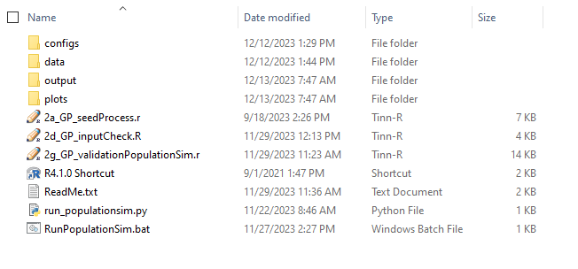
Folder Structure
Notes:
There are four main folders (configs, data, output, plots), three helper scripts, an R shortcut, a readme with install and running instructions, and then our python and batch files to run.
We’ll go through the folder and look at what is contained, the configs folder has the settings files and controls. The data folder has our input data from last session. The outputs folder is where the output data from a successful run is stored. The plots folder will have validation plots from a run.

Slide 4
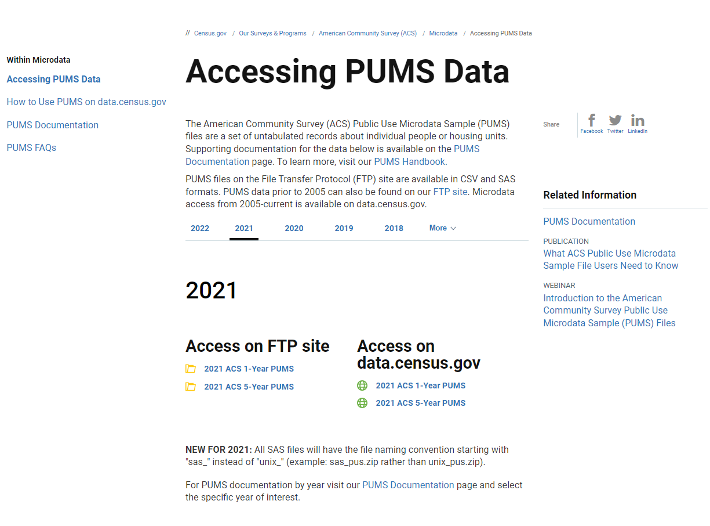
PUMS Data
Link:
https://www.census.gov/programs-surveys/acs/microdata/access.html
Notes:
A quick note here about the PUMS Data, it is easily accessed from this link here. The 2022 ACS 5-Year PUMS data has not been released yet (seeing sometime around January 25, 2024 for release) but I will update the data and process once it is. The new PUMS might follow the 2020 PUMAs and require revision to the geocrosswalk file. There were 31 PUMAs in the 2010 and 34 in the 2020

Slide 5
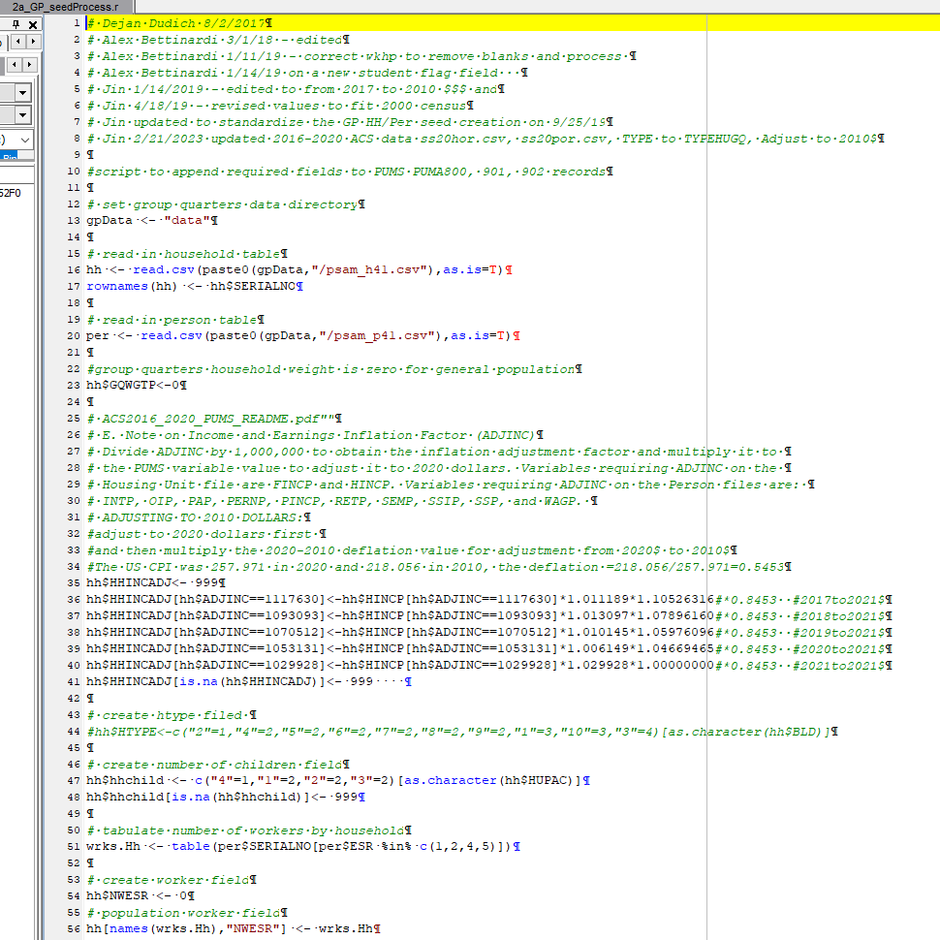
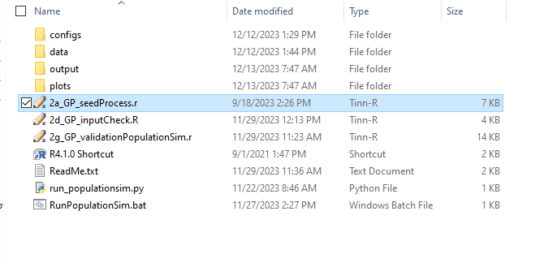
2a_GP_seedProcess.r
Notes:
Alex will guide us through the General Population Seed Processor Script in the main folder, and the configs folder and files in it. I’ll hand it off to you Alex, just let me know when you want me to flip slides.

Slide 6
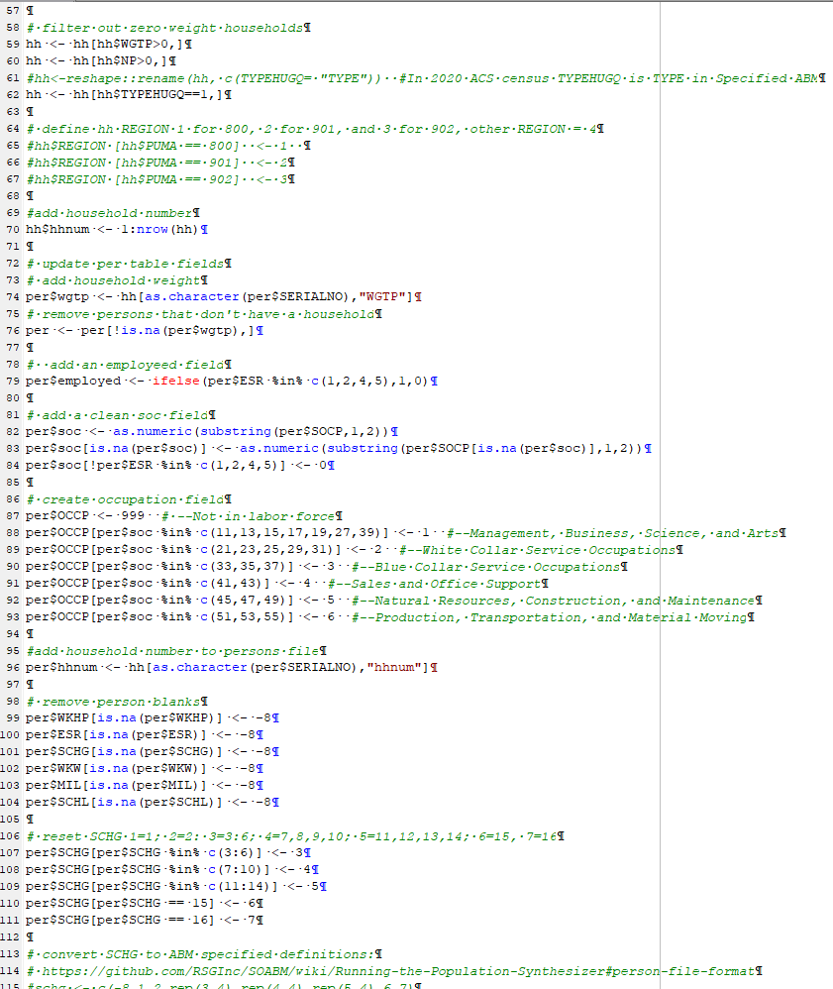
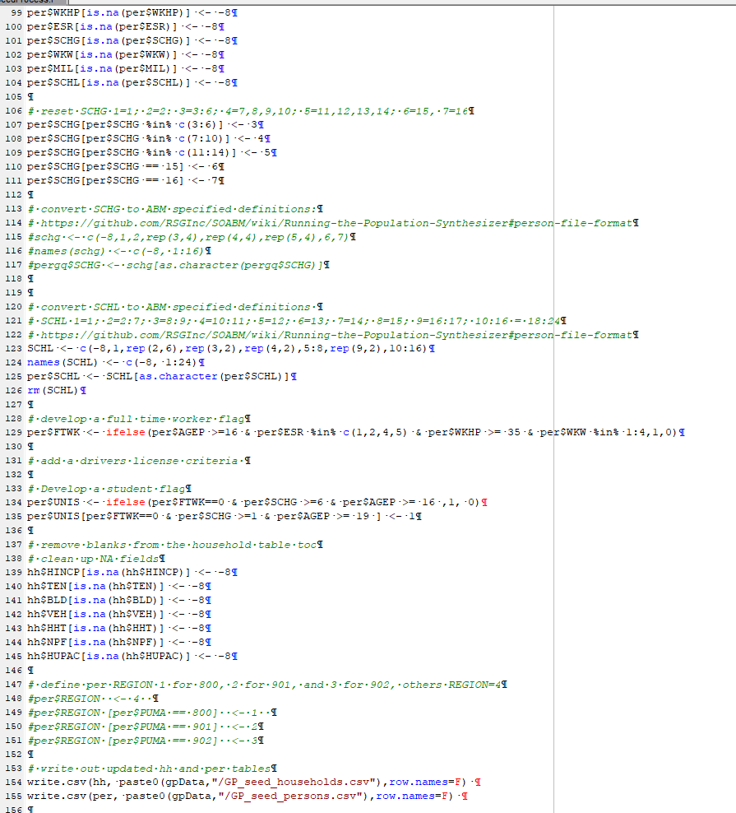
2a_GP_seedProcess.r
Notes:
Alex’s

Slide 7
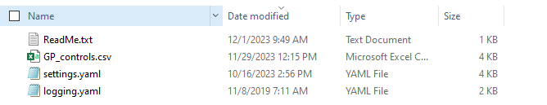
Configs Folder
Notes:
Alex’s: Has control file we’ve already seen that specifies the fields to control the seed tables (pop, hh) on

Slide 8
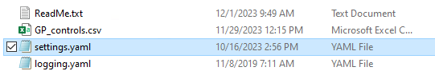
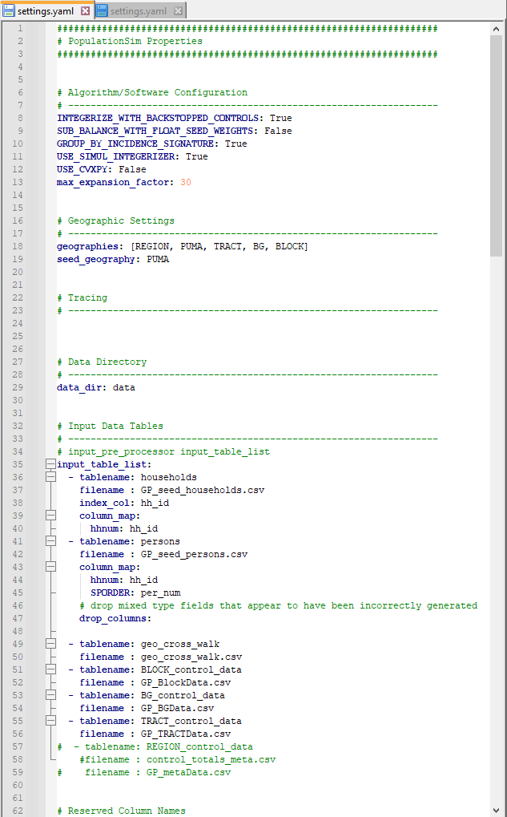
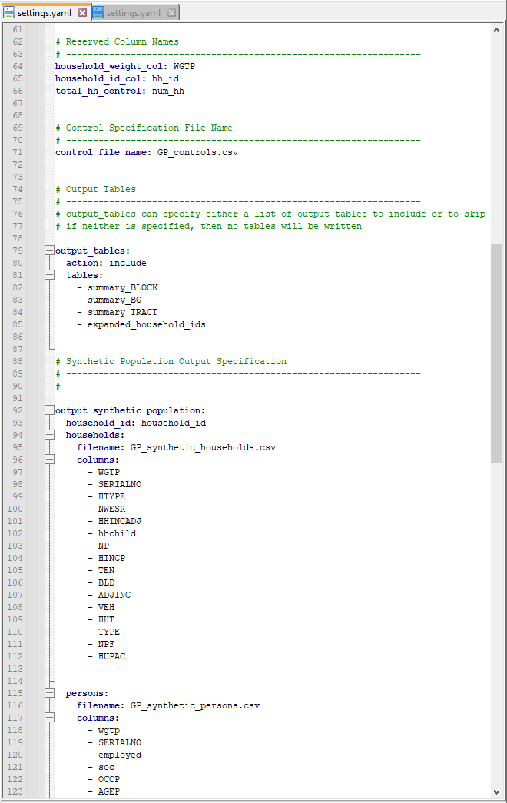
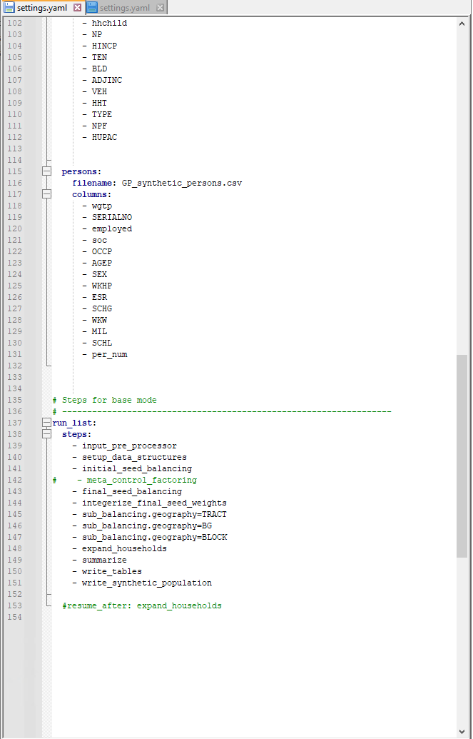
Configs Folder
settings.yaml
Notes:
Alex’s

Slide 9
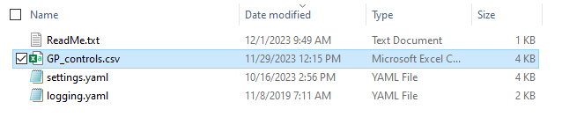
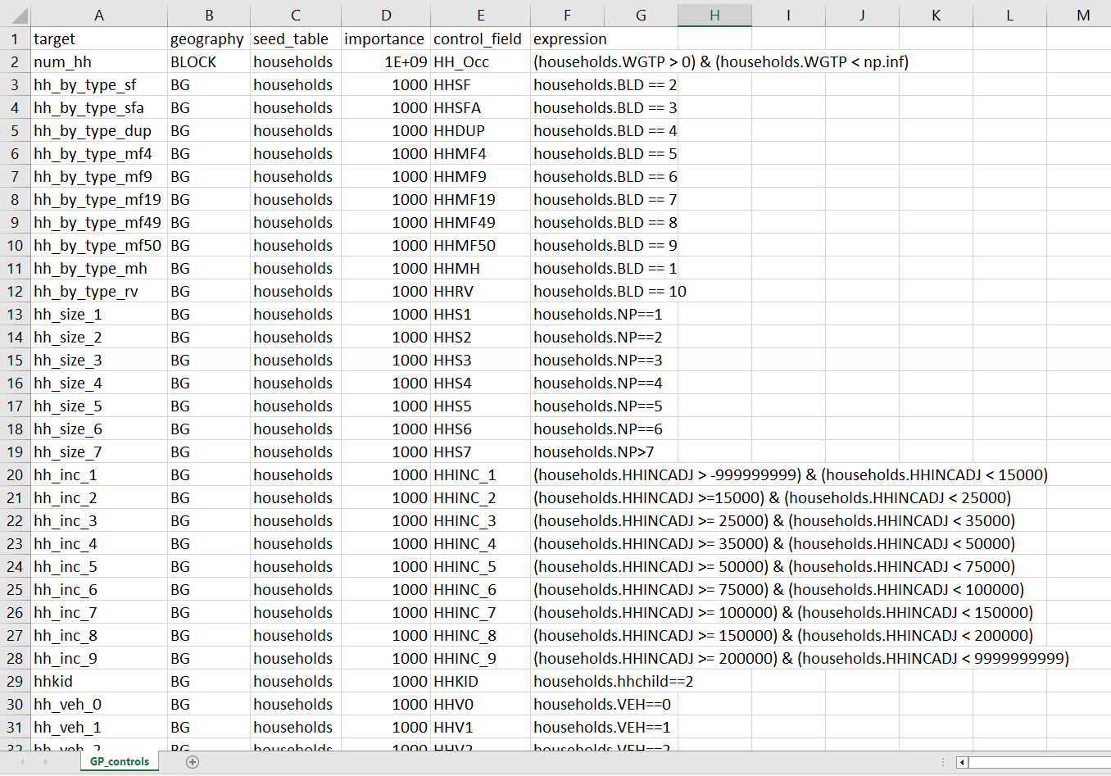
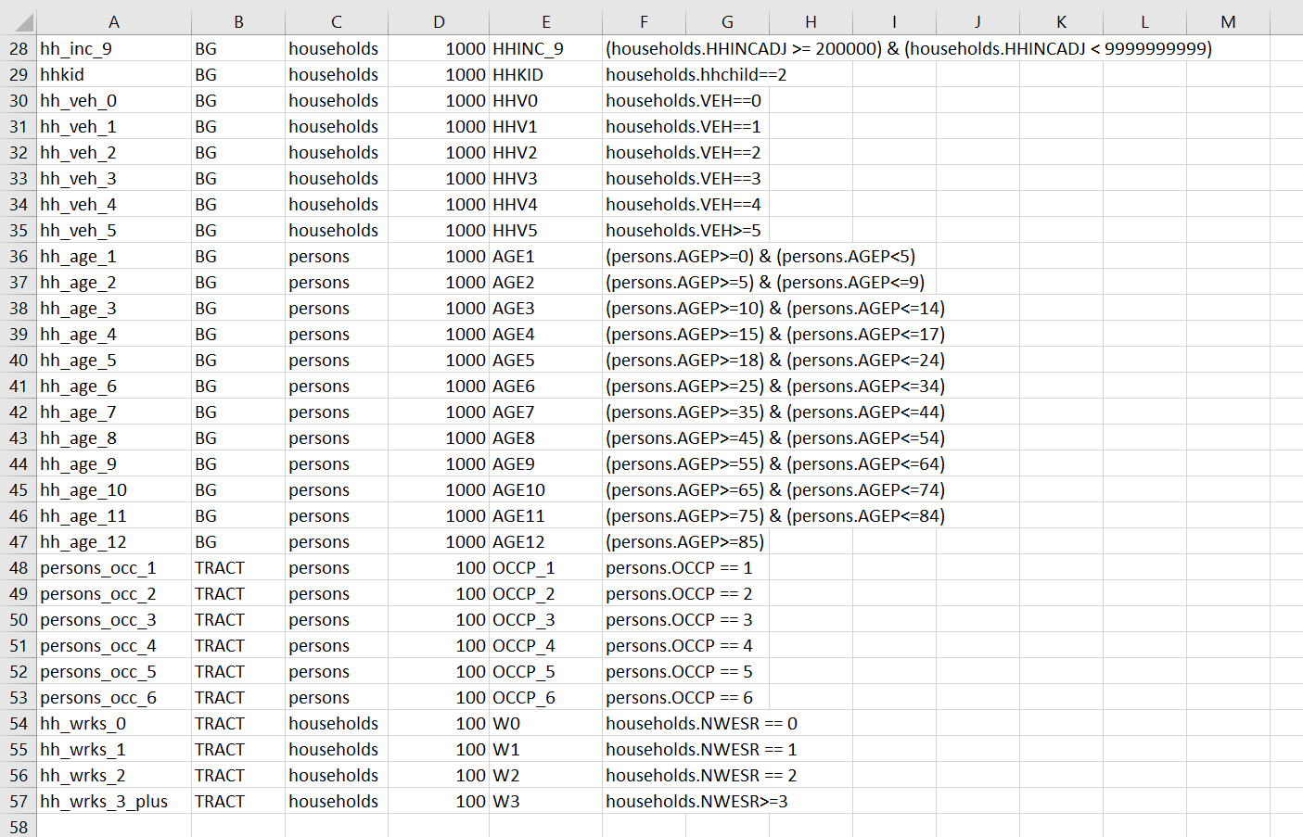
Controls
Notes:
Alex’s:
The controls are built around the variables we pulled out from the census data and tell PopulationSim what to try and ensure is correctly represented in the output synthetic population.
There’s an importance field that allows for different levels of emphasis on different control fields.
Here households has by far the highest importance because we want that to be the most accurately represented

Slide 10
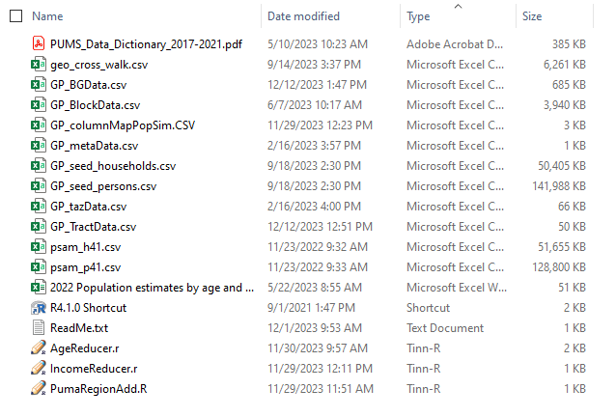
Data Folder
Notes:
All of the input data, seed data, geocrosswalk.
The scripts here – we’ve already looked at PumaRegionAdd.R – it’s the script that aligns Pumas and adds regions to geocrosswalk. The other two we’ll look at in a moment.
Psam_h and p are the files fed into the seed processor script and the GP_seedhouseholds and persons csv’s are output of the seed processor.
GP_BlockData.csv is the processed data from the Decennial census, GP_BGData .csv is the processed data from the ACS5 for block group, GP_Tract has for tract
Geocrosswalk aligns the geographies of the data
2022 Population estimates by age and sex and PUMS_Data Dictionary are supplemental references.

Slide 11
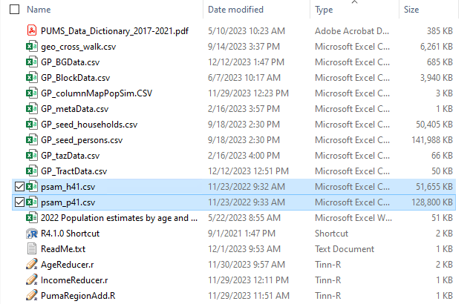
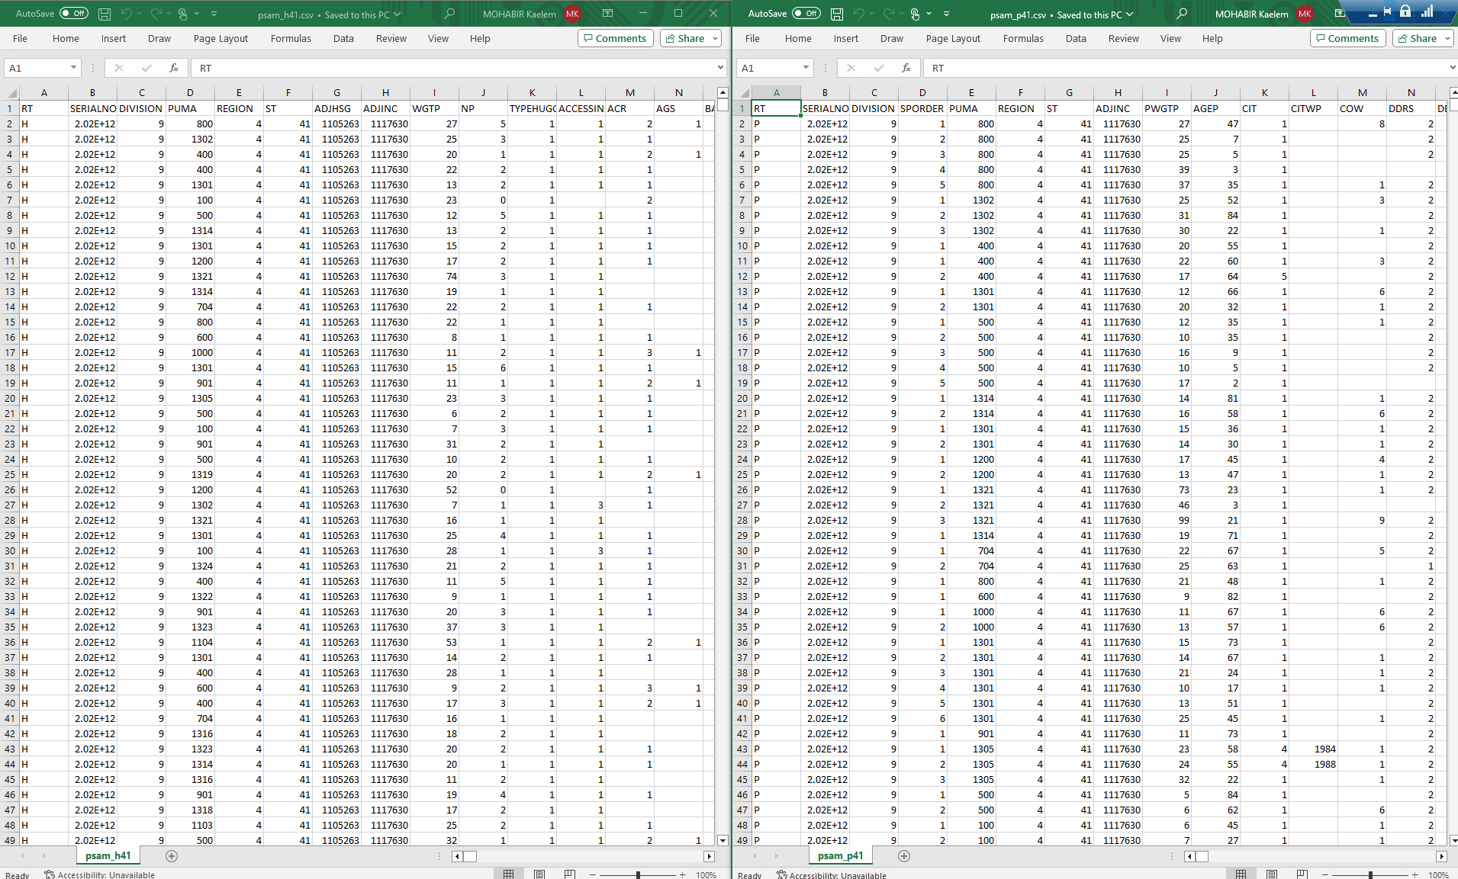
psam_h41.csv, psam_p41.csv
Notes:
These are the household and persons tables that feed into the seed processor

Slide 12
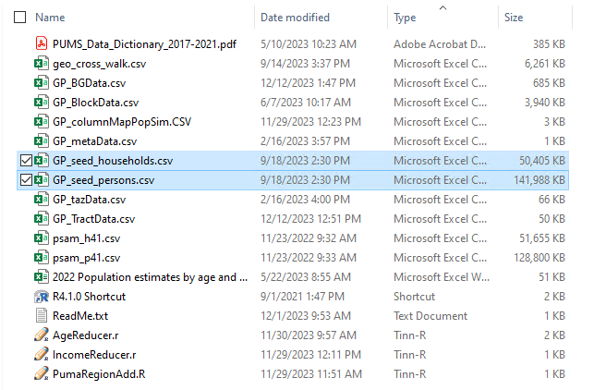
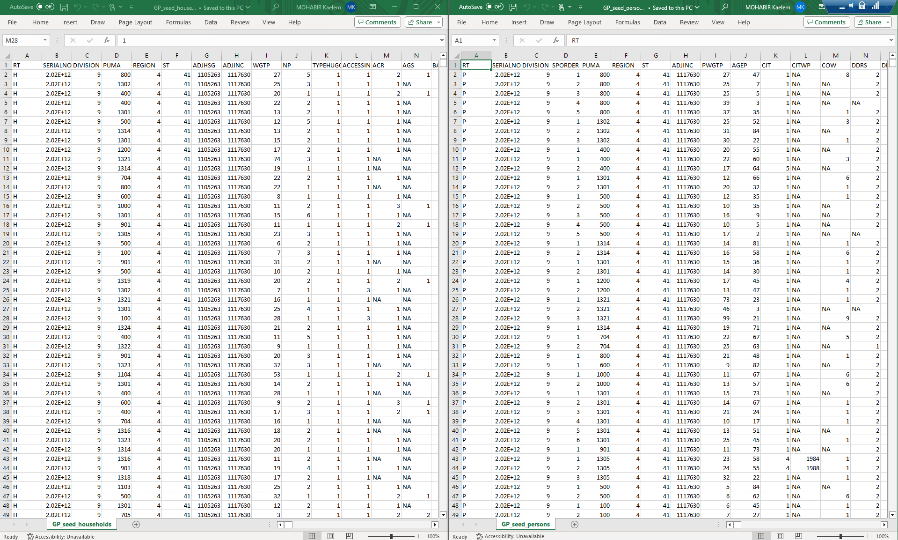
GP_seed_households.csv,
GP_seed_persons.csv
Notes:
And these are the output household and persons files that are the product of the seed processor

Slide 13
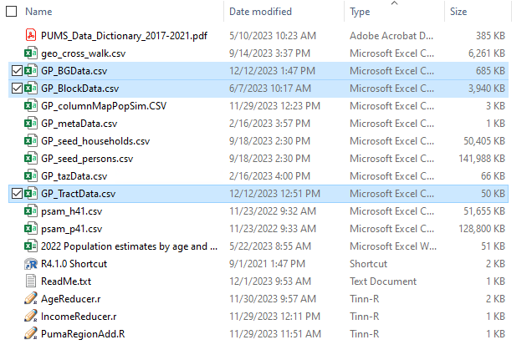
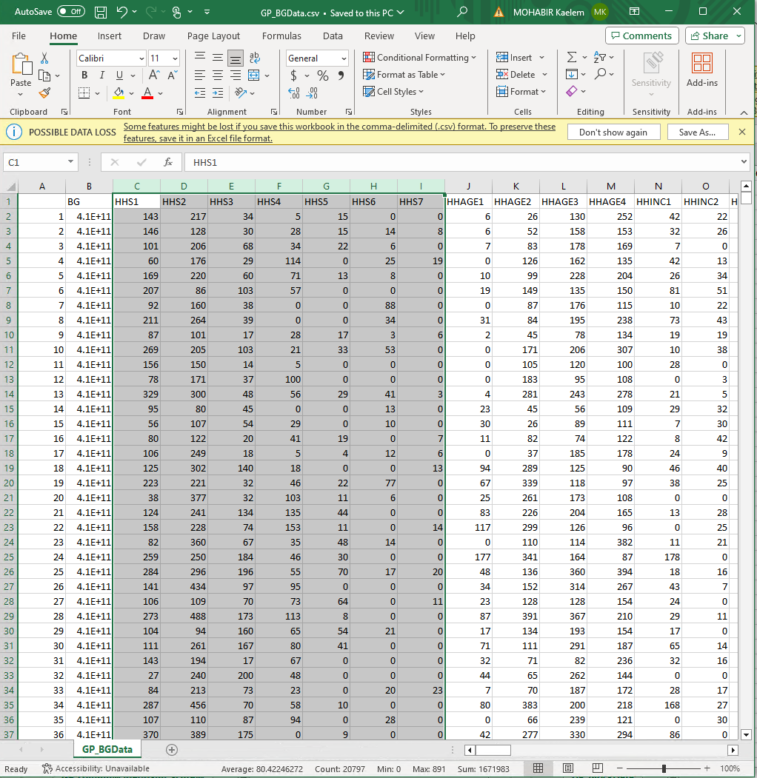
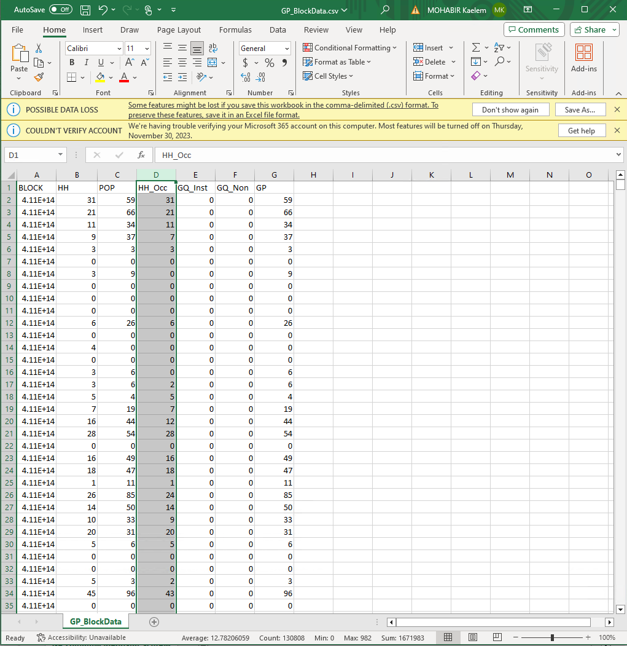
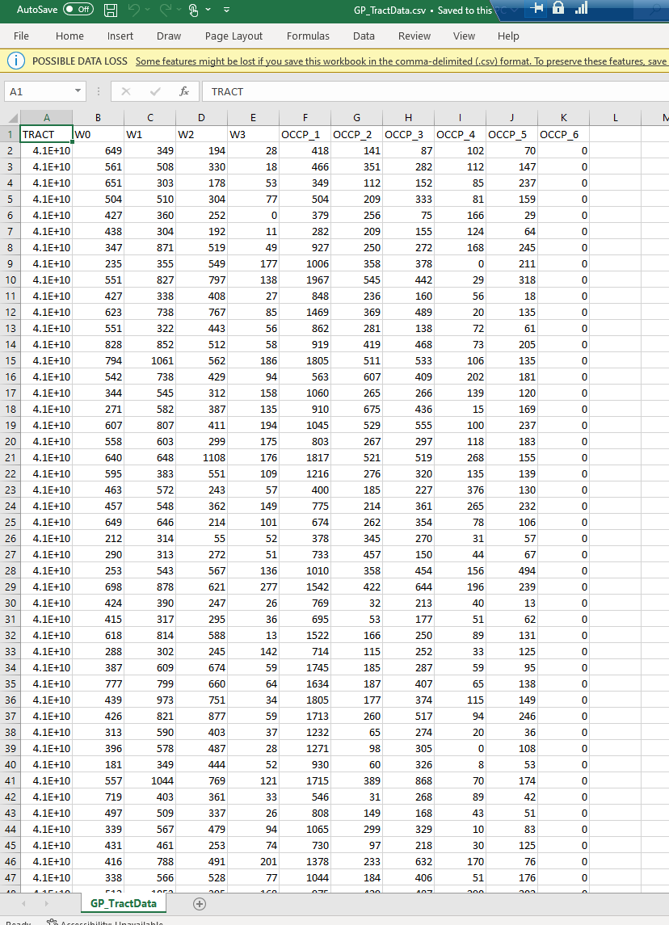
GP_BGData.csv, GP_BlockData.csv, GP_TractData.csv
Notes:
GP_BGData.csv, GP_BlockData.csv, and GP_TractData.csv are the products of the ACS5 and Census 2020 data pulling at the Block, Block Group, and Tract geographies. Notice how the Sums total to the same for HH_Occ and HHS1-7 as they both are household fields.

Slide 14
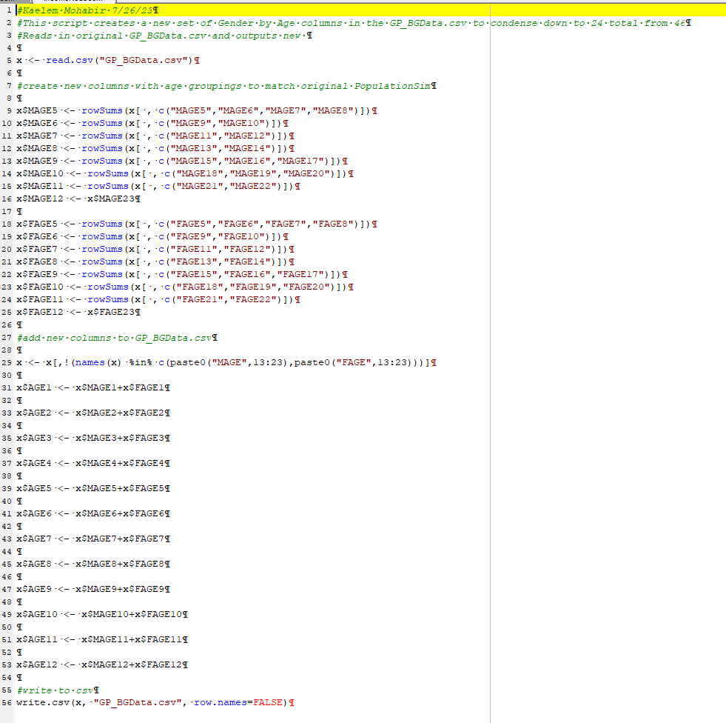
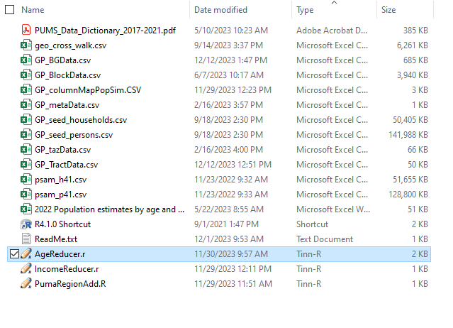
AgeReduce.r
Notes:
This script consolidates the 46 Gender by Age categories down to 12 Age categories. Census data gave us 23 Male and 23 Female age categories and the output was just a little too messy with that much detail. So this condenses it down to 12 age groupings without gender specificity

Slide 15
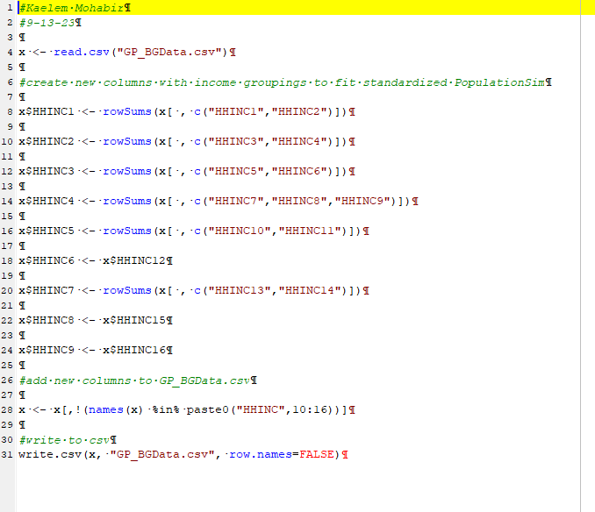
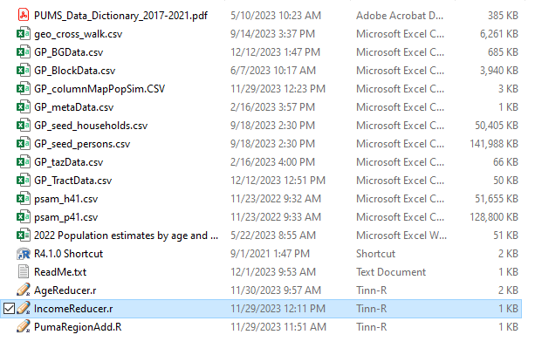
IncomeReduce.r
Notes:
This script reduces the 16 income groupings from the census data down to 9. Again here census gave us a bit more specificity than we needed and reducing the detail here helps with the output validation.

Slide 16
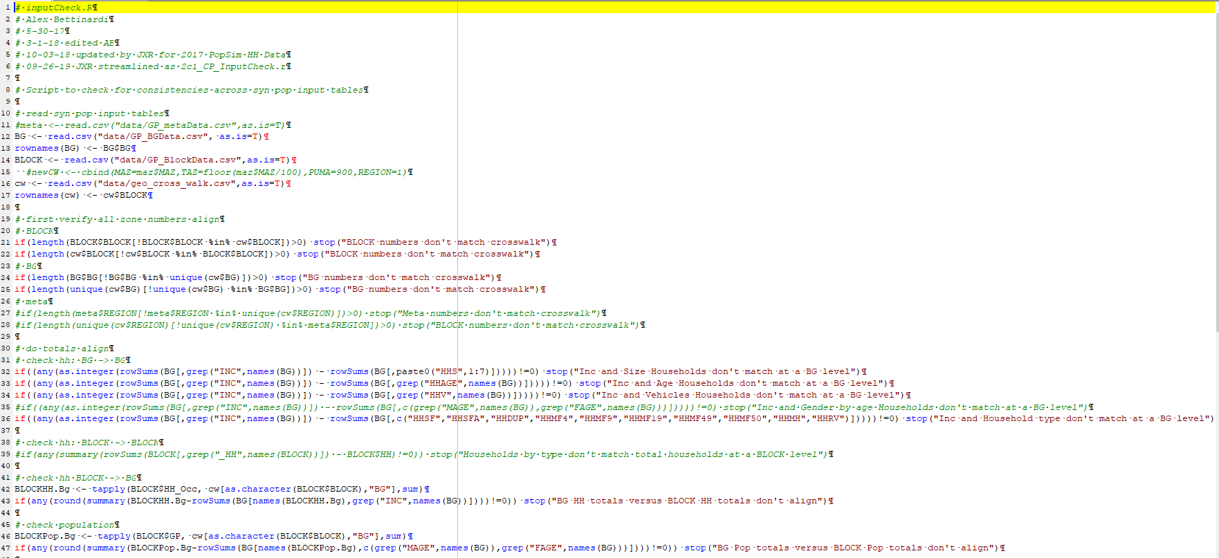
2d_GP_inputCheck.R
Notes:
This script is in the main folder. You would run this once you think all of your pulled input data is current, processed and ready to run. The script has some simple checks to make sure everything matches up at different geographies and will flag an error if catches anything. It’s a good quick check to run before kicking off a run if you’ve changed any of the input data.

Slide 17
Controls
Notes:
A quick look at the controls again here for reference before we move on to the next file (GP_columnMapPopSim.csv). The controls have to align 1:1 with the next file for the validation to work.
//The controls are built around the variables we pulled out from the census data and tell PopulationSim what to try and ensure is correctly represented in the output synthetic population.
//There’s an importance field that allows for different levels of emphasis on different control fields.
//Here households has by far the highest importance because we want that to be the most accurately represented

Slide 18
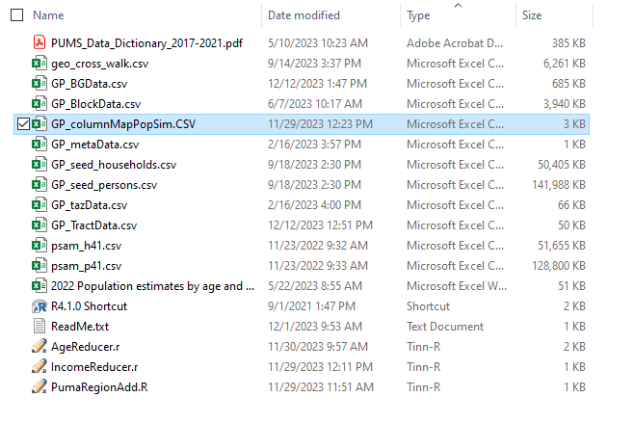
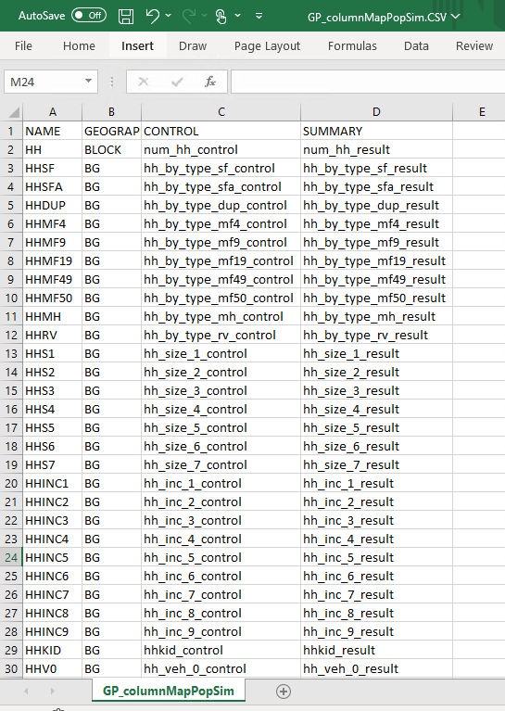
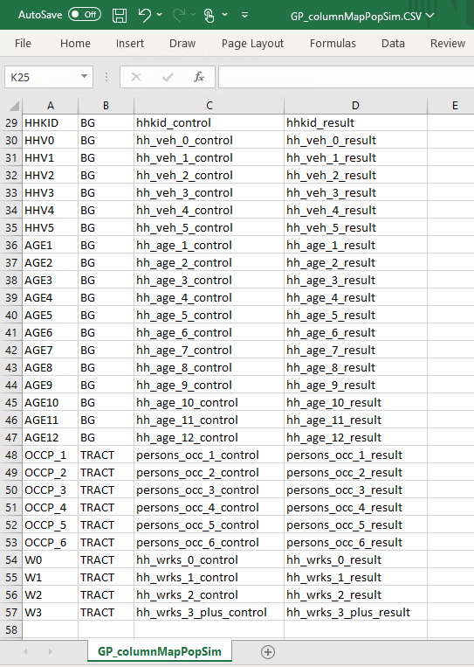
GP_columnMapPopSim.csv
Notes:
This is the GP_columnMapPopSim.csv. It’s used by the validation script to produce the validation plots for each control. This csv must match control fields to work. So if you were to change any fields you were controlling on, you would need to update this csv to generate validation plots.

Slide 19
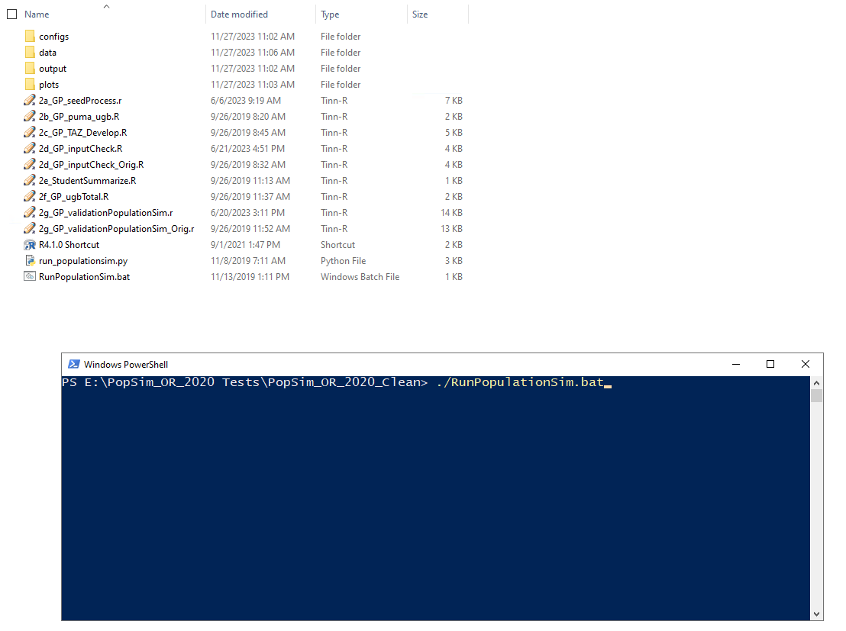
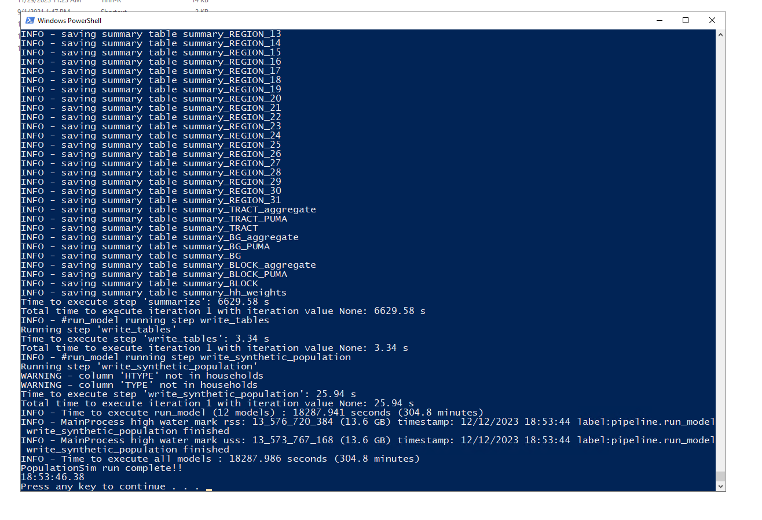
Running PopulationSim
Notes:
Now that all of our data is ready in the data folder and we’ve checked the input and our control file in the configs folder is all set up we’re ready to run. Pretty simple to run, navigate to the main folder, right click in the whitespace and open powershell window and then drag the RunPopulationSim.bat file into powershell and hit enter. The runs can take between 5-8 hours for the General Population (right now we’re sitting around 300 minutes or 5 hours) to under a minute for the GQ

Slide 20
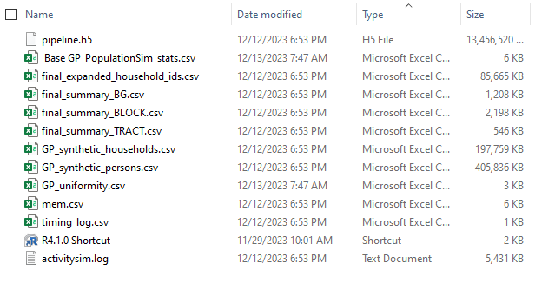
Outputs
Notes:
Ok now that we’ve had a successful run we can navigate to the outputs folder and see our newly generated output files. The final summary csv’s are broken down by their geographies. The Base GP_PopualtionSim_stats.csv and G_uniformity.csv files are actually generated by the validation script and contain a lot of the same info as the validation plots, but in tables.
The GP_synthetic_households.csv and GP_synthetic_persons.csv have all of our output households and persons.

Slide 21
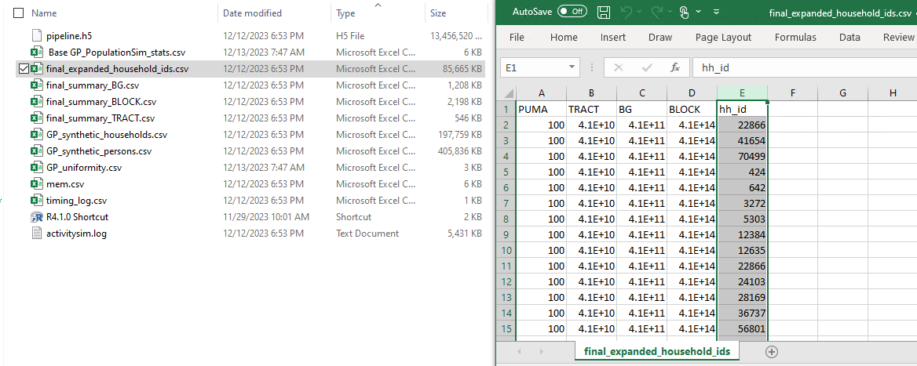
final_expanded_household_ids.csv
Notes:
This file has all of the expanded household ID’s broken down by geography

Slide 22
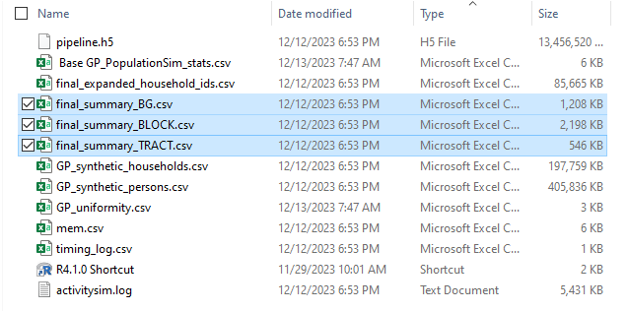
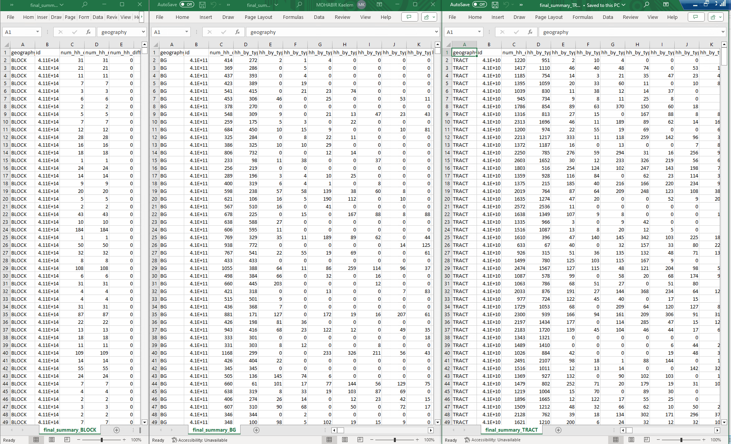
Final_summary.csv’s
Notes:
The three geographic summary csv’s for Block, Block Group, and Tract shows the number of each variable for that geographic unit

Slide 23
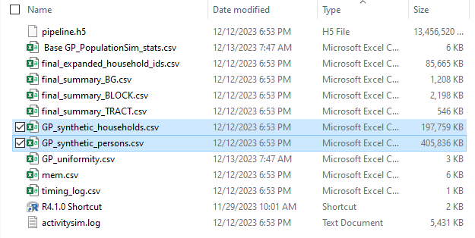
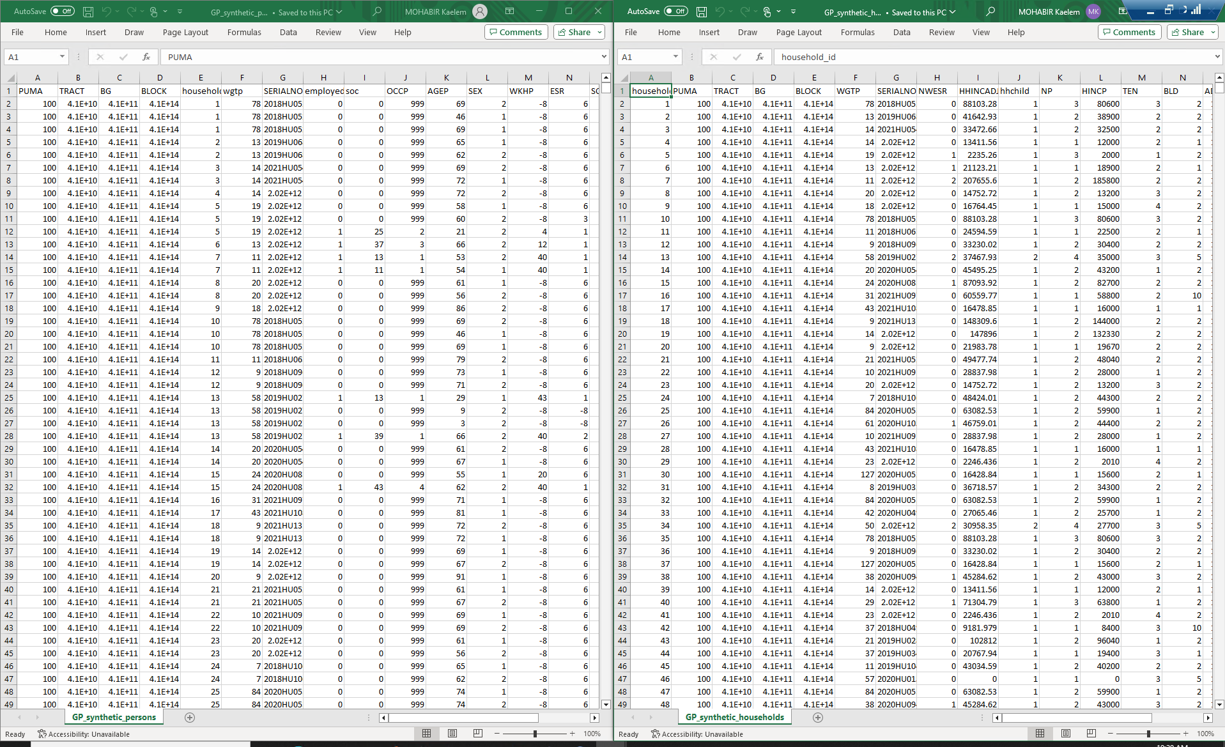
GP_synthetic_persons.csv, GP_synthetic_households.csv
Notes:
Output persons and households with their individual characteristics

Slide 24
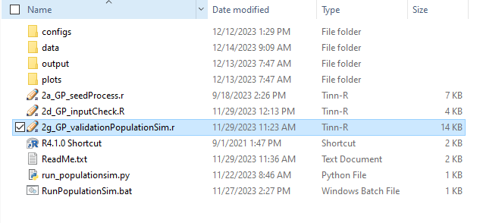
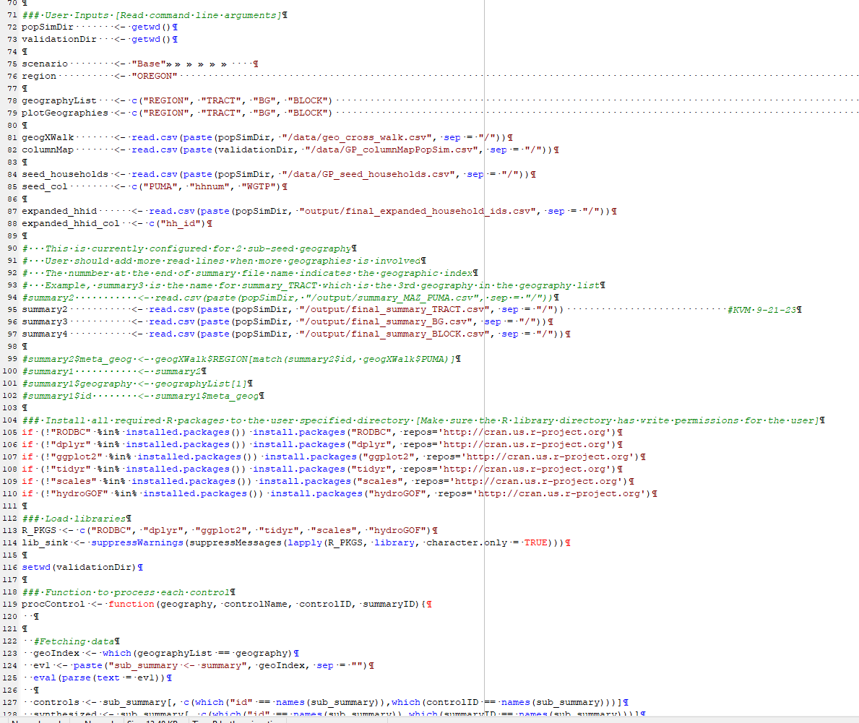
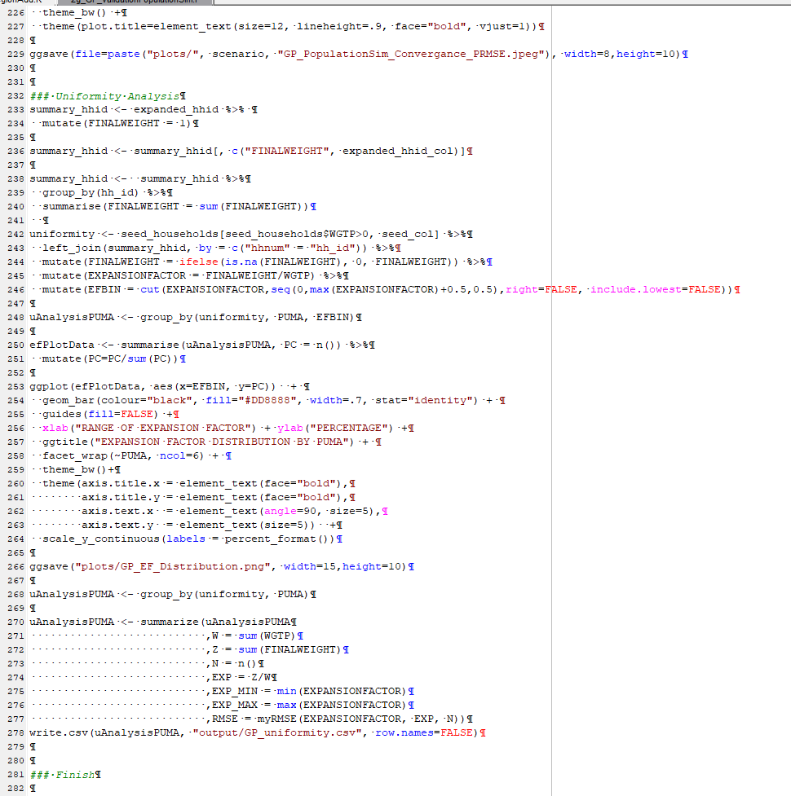
2g_GP_validationPopulationSim.r
Notes:
Now that we have our outputs we can move onto the validation script (this is what requires the columnmap to align with the control file). This script reads in the seed files and the output files to see how closely the output population hit the ideal center for each control.

Slide 25
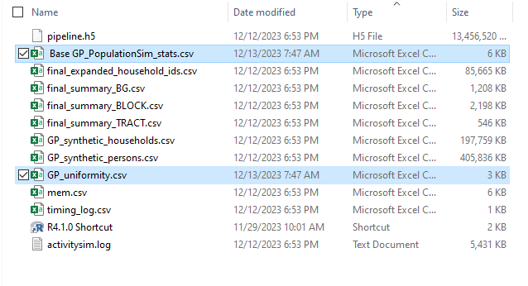
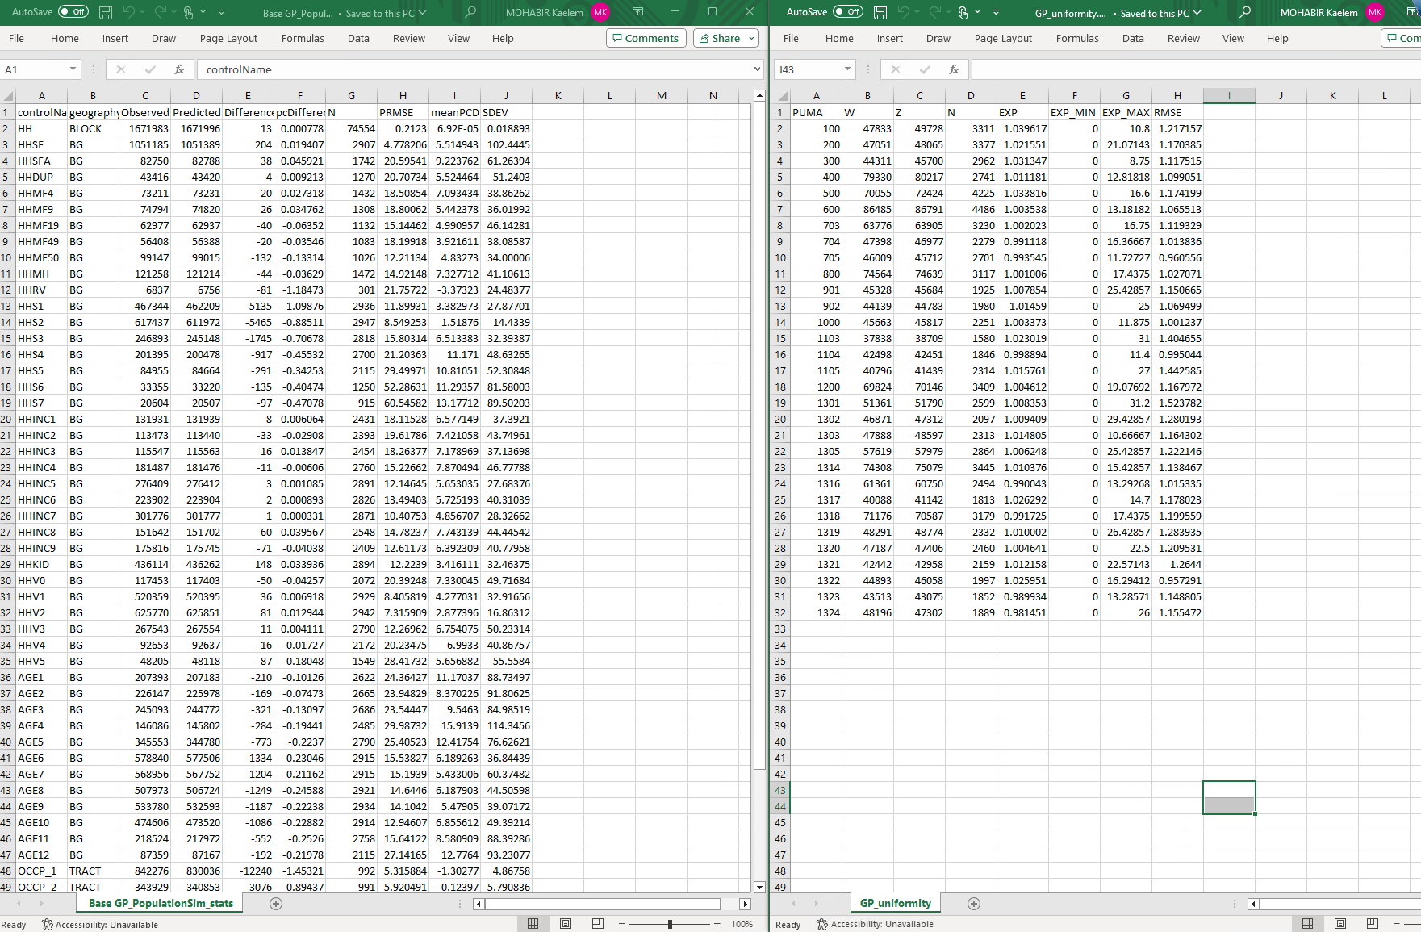
Base GP_PopulationSim_stats.csv,
GP_uniformity.csv
Notes:
Here is the output of the validation in tables, the plots are visually more digestible

Slide 26
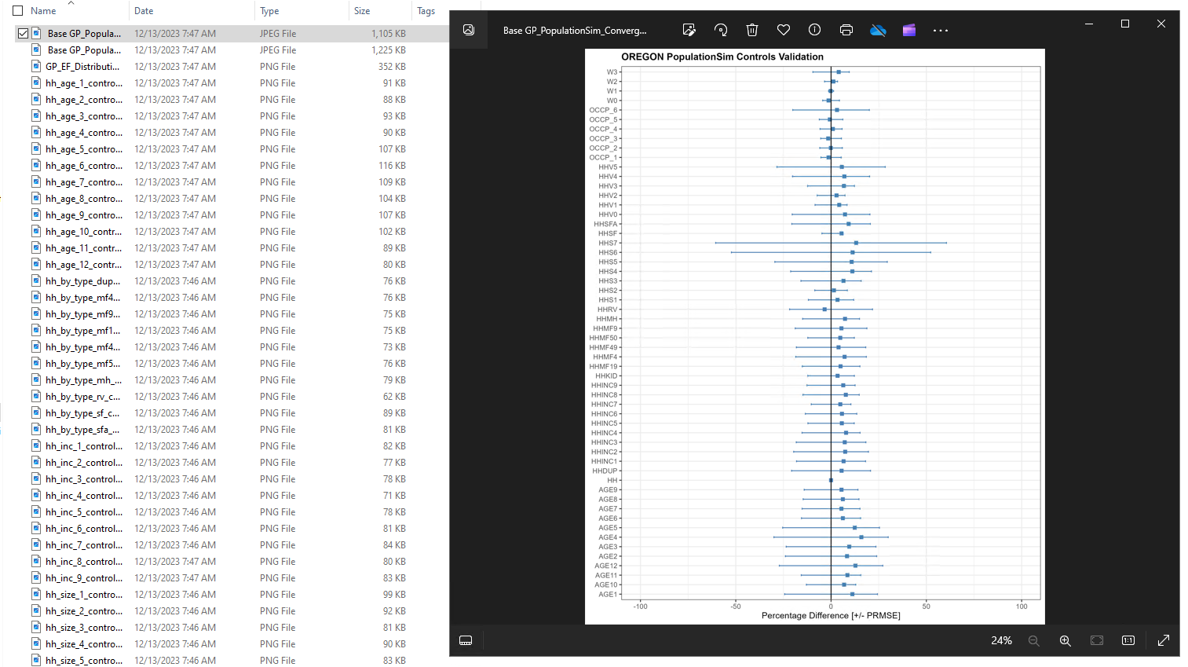
Plots
Notes:
Here are the plots. You can see how far away each control’s mean square error is and the range for each control. If we look here we can see the Households control is dead on (that was what we had the highest importance for by far in the controls because it was what we wanted to be most accurate in the output). So this plot shows the overall picture for every control in the run

Slide 27
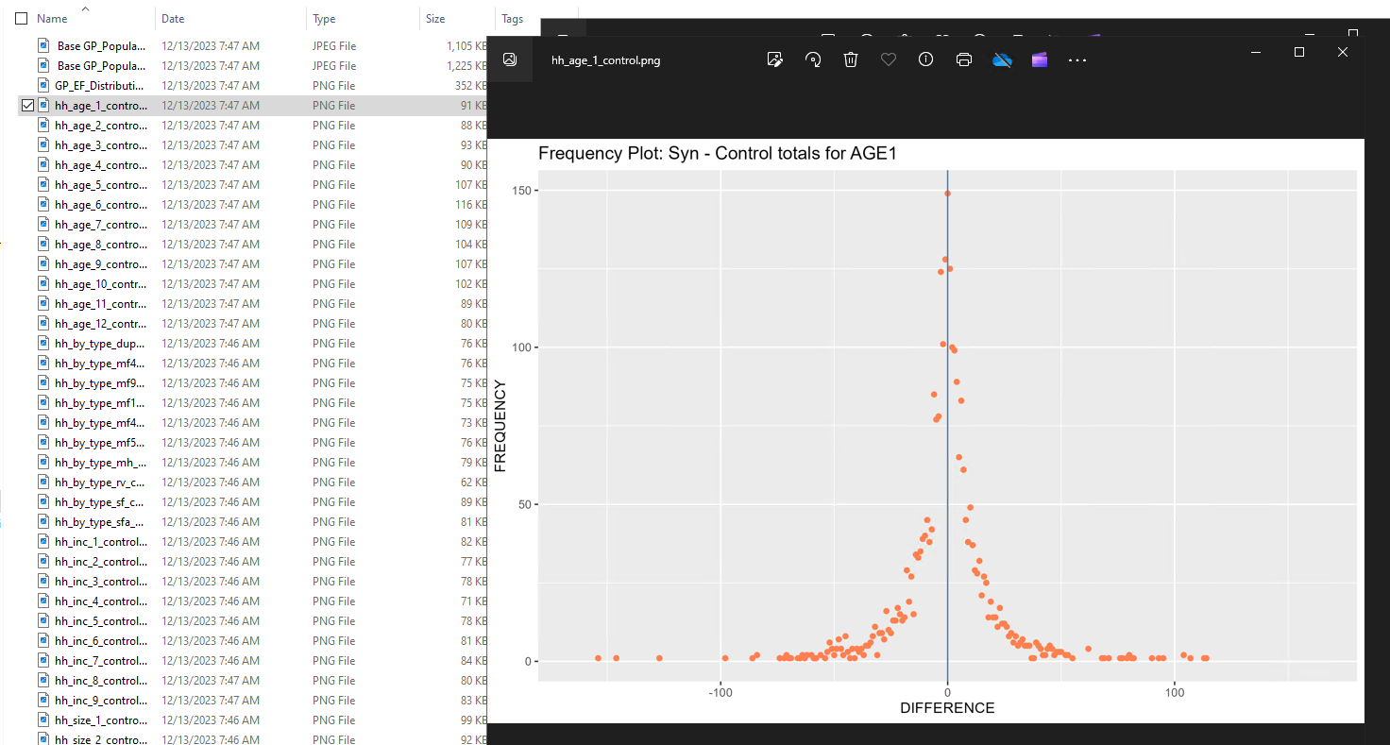
Plots
Notes:
Each individual control also has its own frequency plot as shown here for AGE1

Slide 28
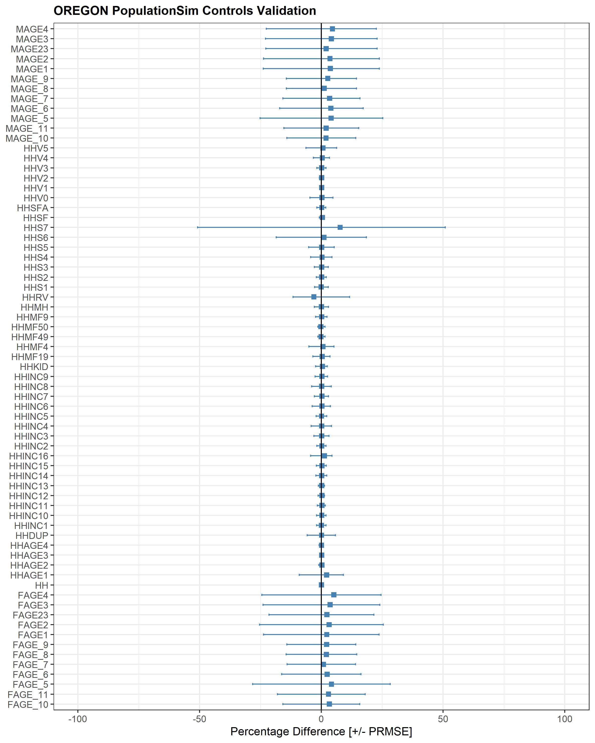
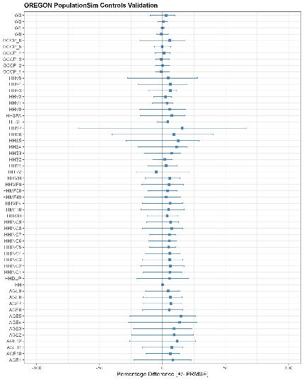
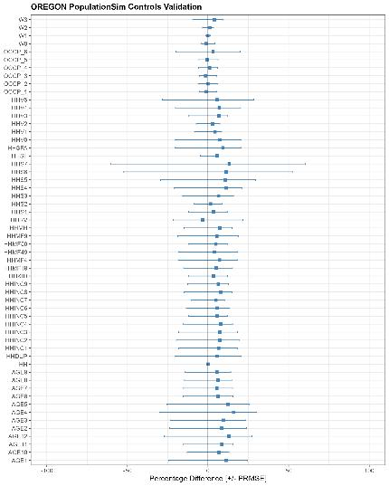
Validation Results Progression
No Tract Controls, Age by Gender
Tract Controls ACS5 2021
Tract Controls ACS5 2022

Slide 29
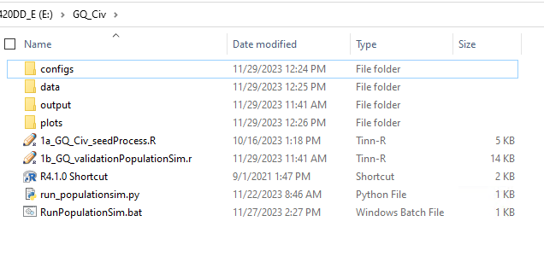


Group Quarters

Slide 30

Group Quarters – Controls

Slide 31

BlockTrim.r

Slide 32



GQ Seed Processor

Slide 33

Group Quarters – Subset Data

Slide 34

Group Quarters – Validation

Slide 35
Questions

